Slide 1
Reactive, Proactive, and Passive Learning About Incomplete Actions
Christopher Weber and Daniel Bryce

Slide 2
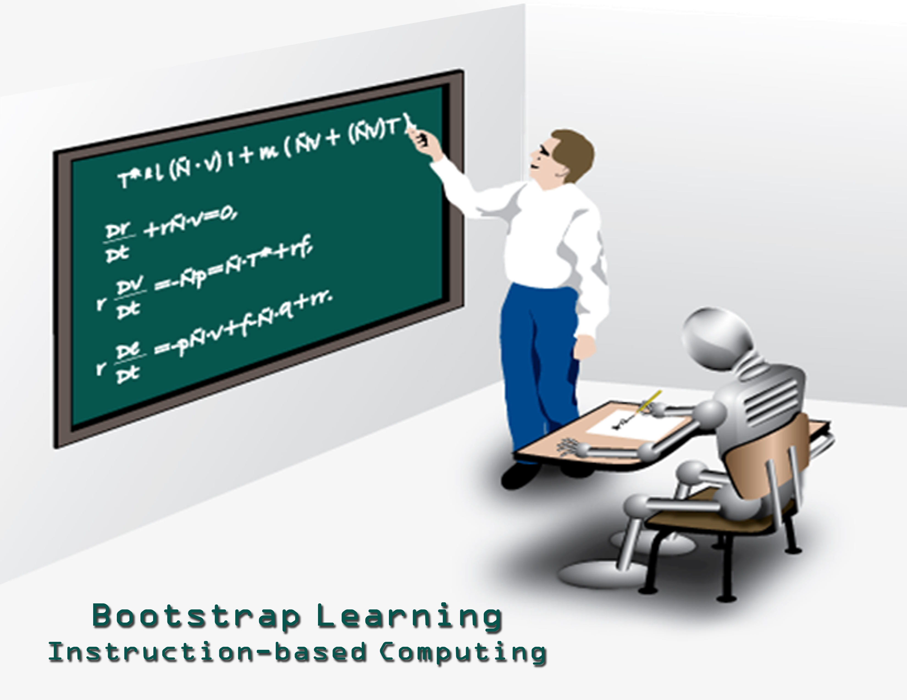
Motivation
Train Agents cheaply
Perfect Knowledge Engineering is Costly
Asking lots of questions is annoying
Plan and Act with Incomplete Domain Knowledge
Focus on Incomplete Actions, but complete set of Propositions
Notes:
----- Meeting Notes (6/13/11 07:22) -----
Asking questions is costly too

Slide 3
Anatomy of an Incomplete Domain
STRIPS: (P,A,I,G)
P: Set of propositions
A: Incomplete Actions
Known: Preconditions, Adds, Deletes
Possible: Preconditions, Adds, Deletes
Impossible: Preconditions, Adds, Deletes
I: Initial State
G: Goal

Slide 4
PARC Printer
(:action HtmOverBlack-Move-A4
:parameters ( ?sheet - sheet_t )
:precondition (and (clear) (Available HtmOverBlack-RSRC)
(Sheetsize ?sheet A4)
(Location ?sheet HtmOverBlack_Entry-EndCap_Exit))
:effect (and (not (Available HtmOverBlack-RSRC))
(Location ?sheet HtmOverBlack_Exit-Down_TopEntry)
(not (Location ?sheet HtmOverBlack_Entry-EndCap_Exit))
(Available HtmOverBlack-RSRC))
:poss-effect (and (not (clear))))

Slide 5
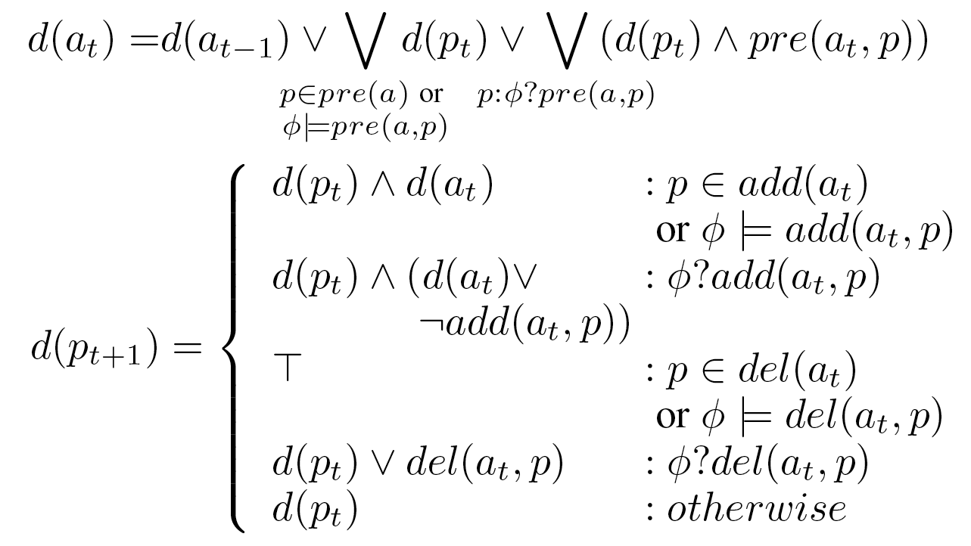
Plan Failure Explanation

Slide 6
Plan Failure Explanations
Propositions = {p,q,r,g}
Incomplete Actions = {a,b,c}
Initial State = {p, q}
Goal = {g}
Incomplete Features = {pre(a, r), add(a, r), del(a, p), del(b, q), pre(c, q)}
Complete Features: pre(a) = {p, q};
pre(b) = {r}, add(b) = {r};
pre(c) = {r}, add(c) = {g}.
State Sequence: (s0 = {p,q}, s1 = {p,q,r}, s2 = {q,r}, s3 = {q,r,g})
Notes:
----- Meeting Notes (6/13/11 07:22) -----
change figure

Slide 7
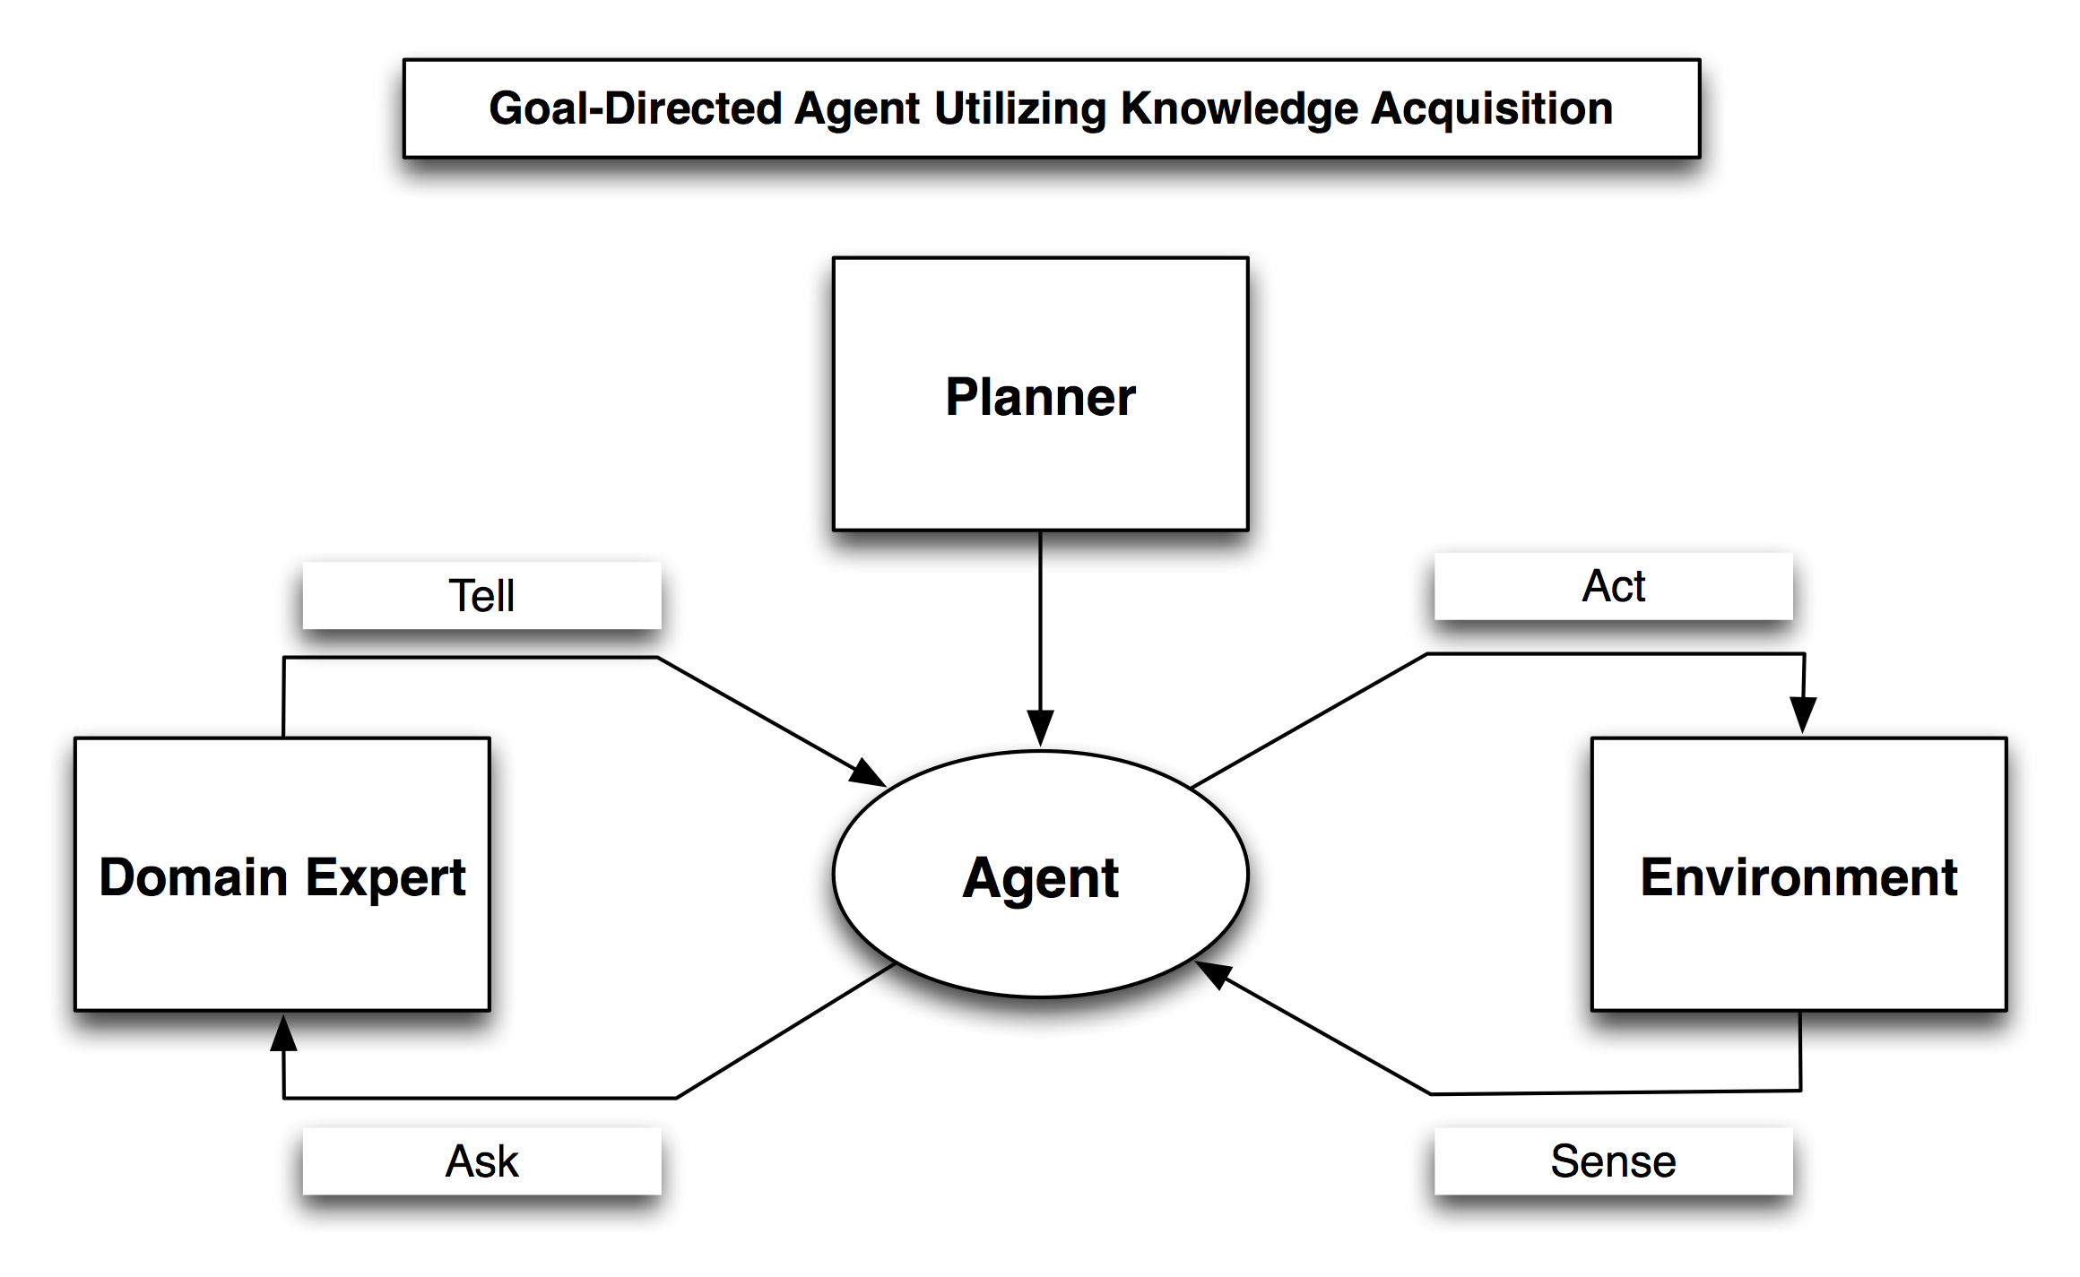
System Overview
Notes:
The agent has an incomplete environment model to perform actions, but its knowledge is incomplete.
It interacts with the environment and the domain expert to enhance its knowledge.
We create a system in which an agent can learn about its incomplete actions and work to achieve its goals:
The agent knows its actions’ possible preconditions/effects.
A simulator has converted the agent’s incomplete actions to complete actions by some designated percentage over all the agent’s actions’ possible pre’s/effects. This master list of complete actions is referenced:
By the domain expert when it is asked a question by the agent.
When an action is applied (during run-time) to any environment state.

Slide 8
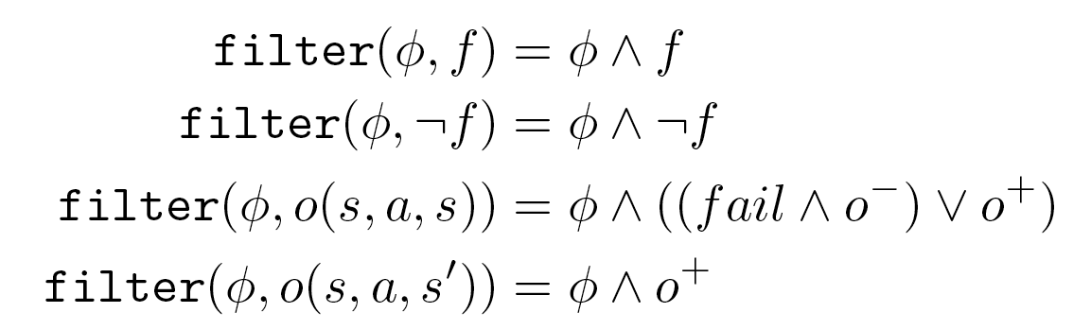
Filtering Observations

Slide 9
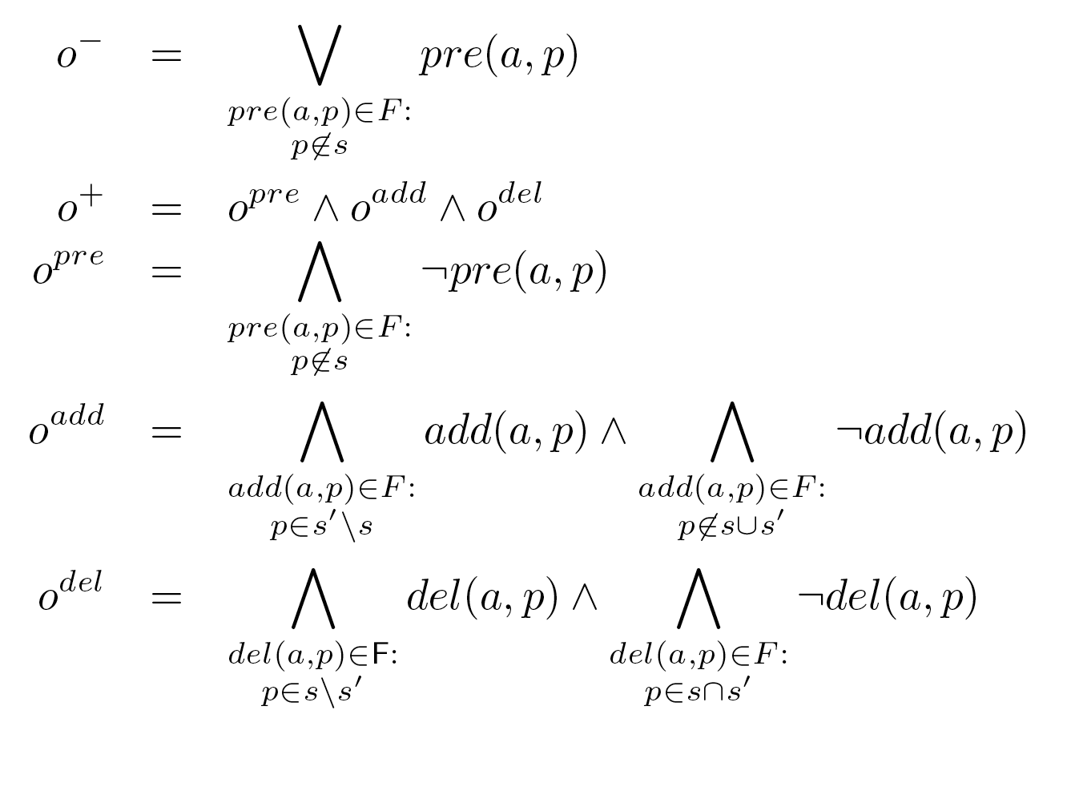
Filtering Observations

Slide 10
Types of Learning
Passive: learn by doing, similar to RL
Reactive: diagnose ambiguities (due to passiveness) after action
Proactive: learn prior to taking action

Slide 11
Passive Learning
Notes:
----- Meeting Notes (6/13/11 07:22) -----
Need to lead in to types of learning

Slide 12
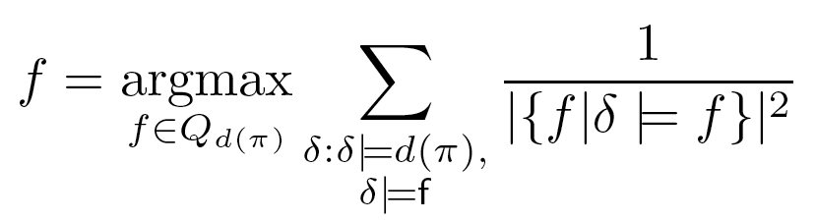
Proactive Learning
1/1²=1
1/1²=1
1/2²=0.25
1/2²=0.25
Notes:
----- Meeting Notes (6/13/11 07:22) -----
Need formula for DI

Slide 13
Passive/Reactive Learning
Notes:
----- Meeting Notes (6/13/11 07:22) -----
Need a better transition into this slide. Why should I care about reactive learning? Fix formula after questions

Slide 14
Passive/Reactive/Proactive Learning

Slide 15
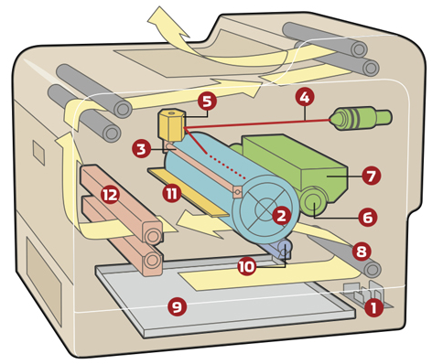

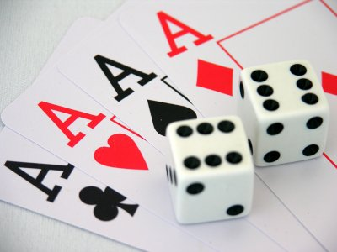
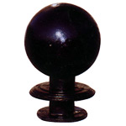




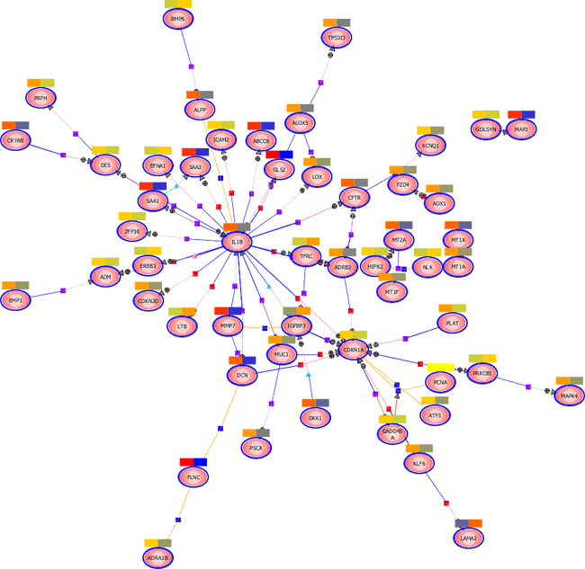
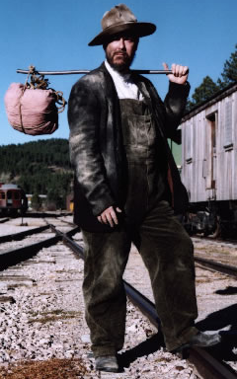
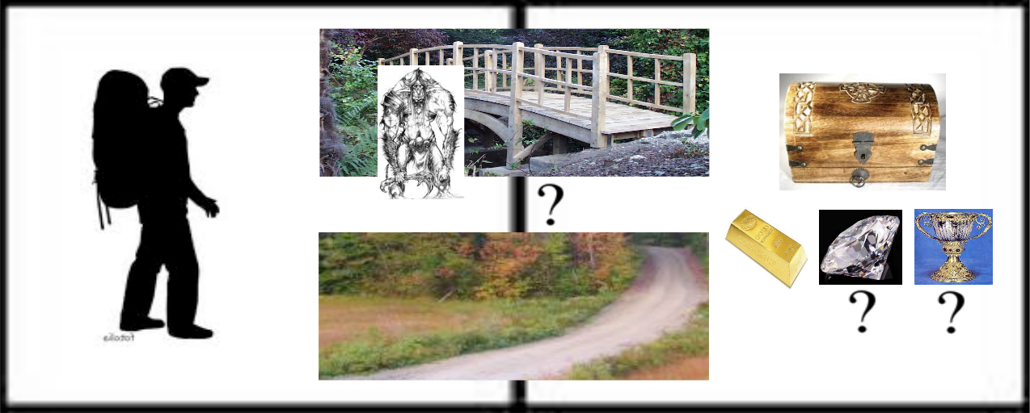
Domains

Slide 16
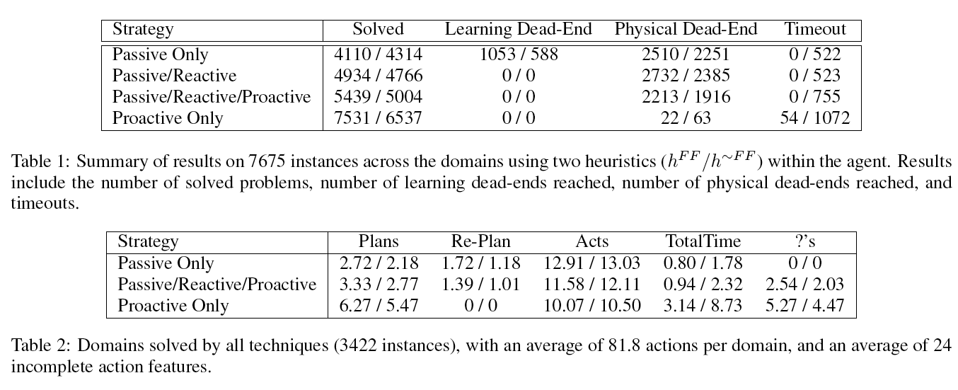
Results
Notes:
Default increases success but scales worse
Passive fails a lot
Proactive asks lots of

Slide 17
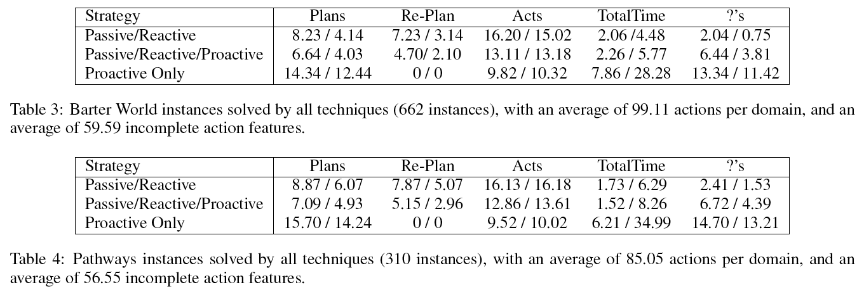
Results

Slide 18
Summary
Multiple Learning Options
Passively learn by execution
Proactively learn by asking
Reactively learn by diagnosing through asking
How to combine?
Passive Only: No questions, high failure
Passive/Reactive: Few questions, high failure
Proactive Only: Many questions, low failure
Proactive/Reactive/Passive: Med. Questions, Med. Failure

Slide 19
Thanks
Come see talk on planner during main session!
Source Code and generators available on web!
http://www.cs.usu.edu/~danbryce/software/default.jar

